Slide 1
Come in Quietly
Concept
Chromebooks - Open to Preamble Rewrite

Slide 2
Objective: Analyze and rewrite the Preamble to the Constitution.
Objective
Standard 8.2.7: Describe the principles of federalism, dual sovereignty, separation of powers, checks and balances, the nature and purpose of majority rule, and the ways in which the American idea of constitutionalism preserves individual rights.
RH 8.7: Integrate visual information (e.g., in charts, graphs, photos, videos, or maps) with other information in print and digital texts.

Slide 3
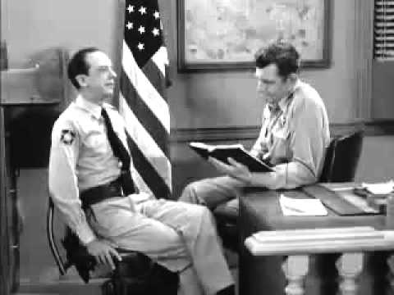
Concept

Slide 4


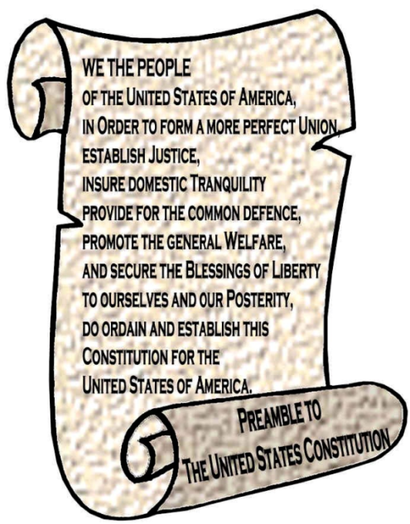
Preamble
Concept
Preamble
The introduction to the Constitution is called the Preamble.
The Preamble begins with the phrase “We the people…”
This means that the government is based on the consent of the people.
The introduction to the Constitution is called the Preamble.
The Preamble begins with the phrase “We the people…”
This means that the government is based on the consent of the governed.
In other words, government gets it power from the people.
The Preamble lists the 6 goals for our Constitution.
We the People, of the United States, in order to form a more perfect union; establish justice, insure domestic tranquility, provide for the common defense, promote the general welfare and secure the blessings of liberty to ourselves and our posterity; do ordain and establish this Constitution for the United States of America.

Slide 5
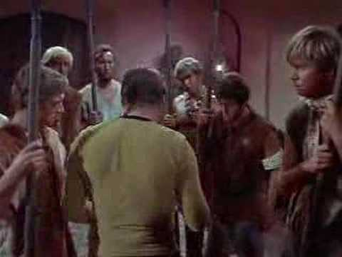
Concept

Slide 6
Steps
Concept
Read the line from the Preamble.
Use the Define menu under Tools to look up any unknown words.
rewrite the line in your own words.

Slide 7
Rewrite the Preamble
Skill - I Do
Preamble of the Constitution
Steps: Read the line (in red) from the Preamble Use the Define menu under Tools to look up unknown words. Rewrite the line in your own words.
We the people of the United States
In order to form a more perfect union
Establish justice
Insure domestic tranquility
Provide for the common defense
Promote the general welfare
And insure the blessings of liberty
To ourselves and our posterity
Do ordain and establish this Constitution for the United States of America
To make a better country.

Slide 8
Rewrite the Preamble
Skill - We Do
Preamble of the Constitution
Steps: Read the line (in red) from the Preamble Use the Define menu under Tools to look up unknown words. Rewrite the line in your own words.
We the people of the United States
In order to form a more perfect union | To make a better country.
Establish justice
Insure domestic tranquility
Provide for the common defense
Promote the general welfare
And insure the blessings of liberty
To ourselves and our posterity
Do ordain and establish this Constitution for the United States of America
set up fair laws and courts

Slide 9
Rewrite the Preamble
Skill - You Do
Preamble of the Constitution
Steps: Read the line (in red) from the Preamble Use the Define menu under Tools to look up unknown words. Rewrite the line in your own words.
We the people of the United States
In order to form a more perfect union | To make a better country.
Establish justice | set up fair laws and courts
Insure domestic tranquility
Provide for the common defense
Promote the general welfare
And insure the blessings of liberty
To ourselves and our posterity
Do ordain and establish this Constitution for the United States of America

Slide 10
Closure:
Closure
Summarize the goals the writers of the Preamble hoped to achieve through the Constitution.

